Slide 1


Data Science

Slide 2
Numpy and Pandas
(ft. Not Ben)
Week 4 of 196 (week 5 of school)
Ben has a midterm :(
Channel: #data_hackerspace

Slide 3
Current
Leaderboard
1st Place: Osmar Coronel
2nd Place: Drake Eidukas
Ish Shah
Matt Cannalte
Tyson Traugar
3rd Place: David Brewster
Justin Chan
Dean Lin
You can still get points by sending us the answers after before the next hackerspace

Slide 4
Week 3 Challenge Answers
One liner by Osmar:
print list(map(lambda filename: [i['lead_paragraph'] for i in json.load(open(filename))['response']['docs']], glob.glob("*.json")))
Two liner by Dean:
for filename in glob.glob('*.json'):
print json.loads(open(filename).read())['response']['docs'][0]['lead_paragraph']
Four liner by Aaron:
for file in glob.glob(‘<path>’):
with open(file) as fileText: jsonText = json.loads(fileText.read())
for i in range(0, len(jsonText[‘response’][‘docs’]:
print jsonText[‘response’][‘docs’][i][‘lead_paragraph’]

Slide 5
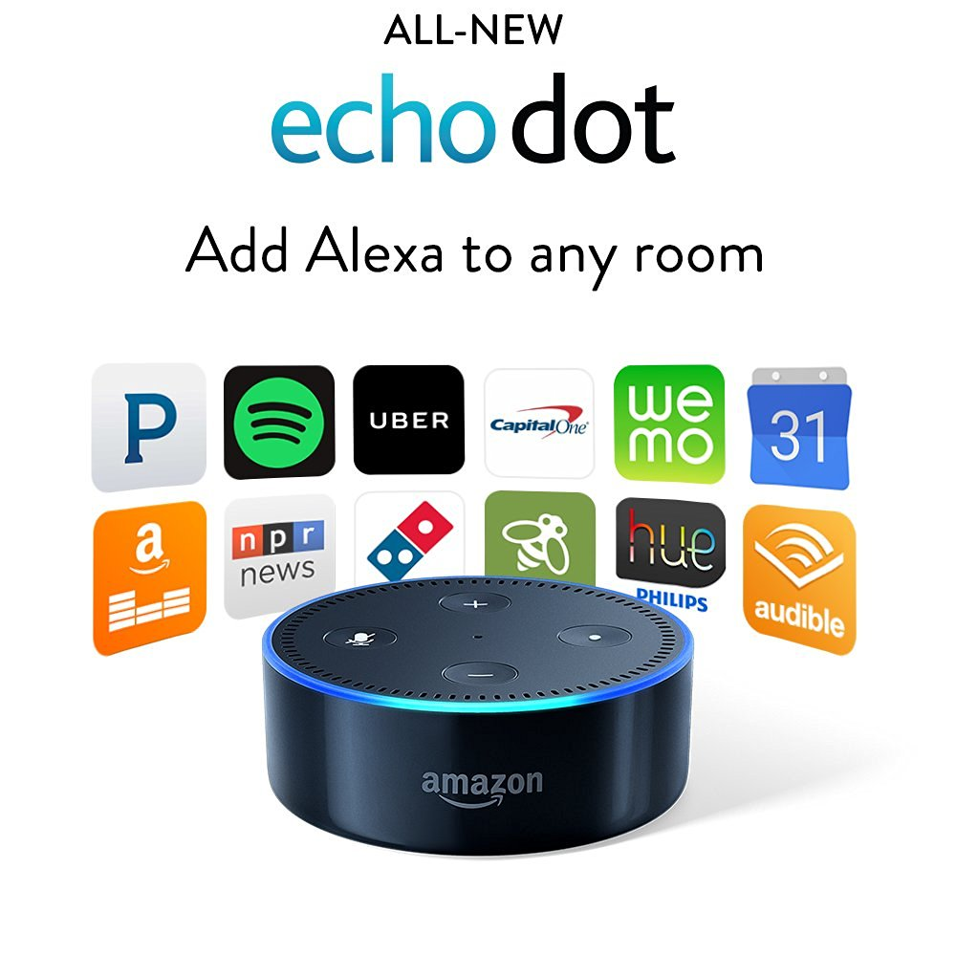
3rd Place
Amazon Echo Dot
X 3

Slide 6
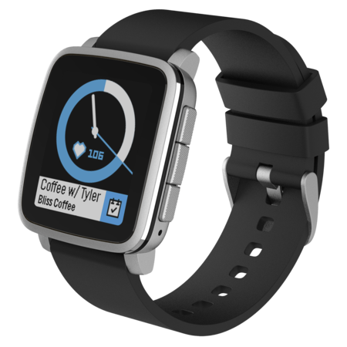
2nd Place
Fitbit Time 2
Or
Pebble 2

Slide 7

1st Place
Mini Jambox

Slide 8
4th Place
The best prize everrr
Selfie Opportunity with Tyler and Ben
AND/OR
Opportunity to take a GenEd course with Tyler next semester

Slide 9
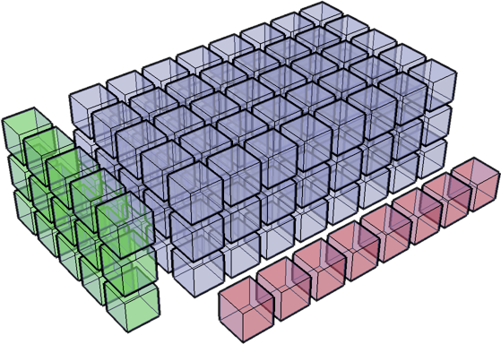
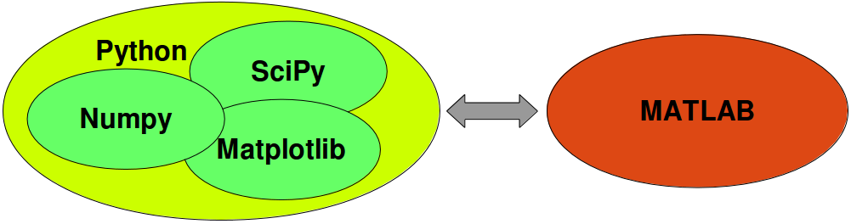
Numpy
Advantages of Core Python:
High-level number objects: integers, floating point
Containers: List with cheap insertion and append methods, dictionaries with fast lookup
Advantages of using Numpy with Python:
Array Oriented Computing
Efficiently implemented multi-dimensional arrays
Designed for scientific computation
Numerical Python...
There is also SciPy,
which is Scientific Python for scientific computing.

Slide 10
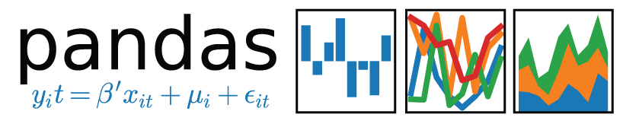
Pandas
I personally don’t use Pandas but-
When to use Pandas :
Indexing
Renaming
Handling Missing Values
map(), apply(), applymap()
groupby()
New Columns = f(Existing Columns)
Basic Stats
Merge, join
Plots
Etc.
DATA FRAME!!!

Slide 11
Jupyter Time
http://tinyurl.com/besthackerspace
#praiseBen

Slide 12
Challenge
Weekly Challenges will slowly develop into Data Science technical interview questions
If you are struggling, come talk to us after each Hackerspace, and/or you can always ping us on slack for help.
Late Submission is a thing.
You need to complete more than 70% of all challenges to get an A in this hackerspace.
Answers to each week’s challenge will be either sent out through emails or announced at next Hackerspace (Depends on how lazy I am that week).
Google is your best friend.
Have fun and enjoy the ride :)
Weekly challenges build on top of each other and will get progressively harder.
Stay on top of them.

Slide 13



